Slide 1
Implementing Predictive Analytics: Practical and Ethical Challenges
2019 COSUAA Annual Conference
Long Beach, CA
Notes:
Alright. Hello everyone! Welcome to our presentation, “Implementing Predictive Analytics: Practical and Ethical Challenges” – I want to thank you for taking the time to join me today, and thank Jim Brooks and company for inviting me to share New America’s research on predictive analytics.

Slide 2
Ernest Ezeugo
Policy Director, National Campus Leadership Council
For more predictive analytics research, connect with New America:
Twitter: @NewAmericaEd
Email: palmer@newamerica.org
Stay in touch!
Twitter: @ErnestEzeugo
Email: ernest@campusleaders.org
Notes:
My name is Ernest Ezeugo. Currently, I’m the Policy Director at National Campus Leadership Council, a non-profit organization dedicated to elevating and strengthening student voice in higher education policy.
But when I got invited to this conference to speak, I was a policy analyst at New America, a think tank in Washington, DC. There, I conducted research for the education policy team on a number of topics, and chief among them is the ethics of predictive analytics in higher education.
My colleague, Iris Palmer, continues to be one of the preeminent researchers discussing the ethics of predictive analytics in higher education. If you’re interested in that, I implore you to seek out New America on social media and follow her work. I’ve also included my contact information.

Slide 3
A Tale of Two Universities
Notes:
I’m going to set the mood here with a tale of two universities using predictive analytics, define uses, potential challenges, and New America’s five guiding practices for ethical use, and then I’m going to give you all a scenario for us to talk about to end the presentation.
First, a Tale of Two Universities.

Slide 4
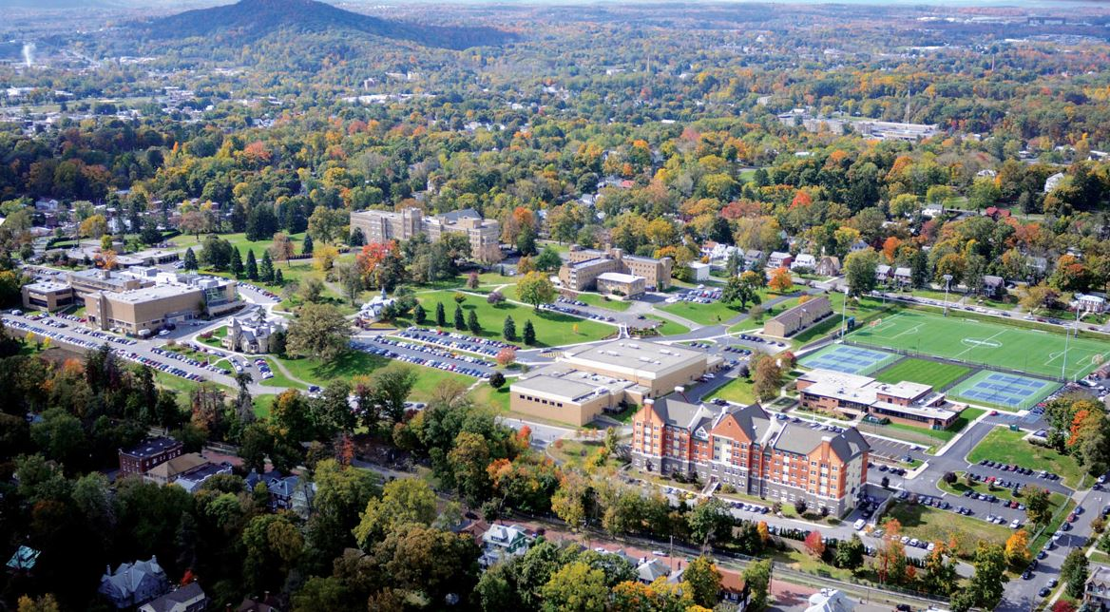
“This is hard for you because you think of the students as cuddly bunnies, but you can’t. You just have to drown the bunnies…put a Glock to their heads.”
Simon Newman, former president of Mount St. Mary University, on a plan convincing students to leave to raise retention rates.
Notes:
The first part of our tale is about Mount St. Mary University. You may have heard the story of Simon Newman, Mount St. Mary’s president from the private sector, who proposed sending out a survey to freshmen that would help highlight which students had the highest risk of dropping out.
Students who took the survey weren’t told how their data would be used. They were only informed that their answers would have no bearing on their time at the university in an email that delivered the survey.
But the reality was that Simon Newman intended to use this data to counsel out the riskiest students--who were least likely to graduate--before the institution had to report their retention rates.
When faculty objected, he doubled down, giving us this gem of a quote. I know y’all can read but I’m going to read it aloud for effect. (Read quote).
So obviously this quote is… aggressive. But let’s examine what else made this situation unethical. It’s bad enough that Newman wanted to use student data to help the college at the expense of the student. But it is especially wrong that students were misled about how their data would be used.
Fortunately, this plan was never initiated. President Newman resigned soon after the news broke in the national media.

Slide 5
“Because of these proactive interventions all students benefited, but the students who benefited the most were first generation, low-income and students of color.”
Tim Renick, vice president of enrollment management and student success at Georgia State University, on the implications of GSU’s use of predictive analytics.
Notes:
The second part of our story is about Georgia State University, where President Mark Becker and Vice President for Enrollment Management and Student Success Tim Renick have used analytics as part of a larger strategy to close achievement gaps at the college.
By now, Georgia State’s story is integral to what it means to use predictive analytics successfully. In 2011, they partnered with EAB to redesign their student advising strategy.
That included hiring 42 new advisers and implementing an early alert system that prompted advisers to have conversations with students who had gone off track.
This led to increased graduation rates and—most impressively—a total closing of the graduation gap between white and black students as well as for Pell eligible students.
And unlike the main character in the first half of our tale, neither Mark and Tim got fired, nor asked to resign. On the contrary, they represent one of the most successful stories of data analytics in higher education.
The moral of this story is that leaders at both Mount St. Mary and Georgia State engaged predictive analytics to achieve their goals. But the ways in which they used it show both the great promise and great peril of using predictive analytics in higher education.

Slide 6
WHAT IS PREDICTIVE ANALYTICS?
When past data is used to make predictions about the future
Notes:
So. What is predictive analytics? Honestly, we could do a whole session on this alone.
In our landscape analysis, we defined predictive analytics simply: when past data is used to make predictions about the future.
To really understand why predictive analytics has such high reward and high risk for higher education, we need to dig a little deeper.

Slide 7
PREDICTIVE ANALYTICS IN HIGHER ED
Enrollment - Recruit, admit, and offer aid to new students
Early Alerts - Identify students at-risk of failing
Recommender Systems - Offer students guidance on course and degree plans
Adaptive Technologies - Help students reach course learning goals
Facilities - Guide colleges in offering the right classes and controlling use of resources on campus
Notes:
In our landscape analysis, we identified a few ways colleges are using predictive analytics for student and institutional success, detailed here.
There’s enrollment. Enrollment management is costly work! Schools are using data to help forecast the size and anticipate the need of incoming and returning classes.
There’s Early Alert Systems. We touched on this a little with Georgia State, but colleges are using data points from all corners and measures of campus life to identify students who are off-track for graduation sooner and intervene earlier.
Recommender Systems. We love the idea of choice, but sometimes we drown students in choice. Colleges are using data to help students choose courses and degree plans that best align with their interests.
Adaptive Technology. Colleges are using data from the classroom to help faculty better teach their students.
And finally, facilities: colleges are using data to manage resources more effectively. This is everything from looking at classroom space to predicting what classes will be in demand and which won’t in a given semester.
Each of these have shown promises results in making things more efficient and helping students meet their goals. But as we talked to colleges implementing these systems for our landscape analysis, it became clear there were potential pitfalls, as well.

Slide 8
Ethical Challenges: Tracking/Streaming Students
Notes:
Tracking (or streaming, or phasing) is the act of separating students by academic ability into groups.
It’s unfortunately too easy to use data and predictive analytics as an excuse to shuffle certain students into certain classes, majors, and pathways.
Of course there are individual reasons that certain students may or may not be “cut out for” certain fields.
If, however, your framework is using historic data to systematically exclude low-income or minority students from majors like engineering, you’re perpetuating a larger cycle of inequality and potentially tracking students who could do well in such majors into majors they may not want and majors with a lower return on investment.
During our research, we spoke to a Latinx graduate from a university I won’t mention who told us a story of how one of her professors once told her she wasn’t cut out for his engineering class because the school’s predictive analytics system said so. The year we spoke to her, she graduated with an engineering degree. Take from that what you will.

Slide 9
Ethical Challenges: Profiling Students
Notes:
Profiling is using a person’s demographic characteristics to predict their capabilities.
Profiling is “past is future, demographics are destiny”, and other phrases that sound cool but can play out problematically in practice.
These systems should tell us more than demographic information.
Our landscape analysis research lead us to one university administrator whose prior job was as a social services manager in a large city. They purchase a system that they were told would help them better target their resources, but all that system ended up telling them was who their poorest residents were.
That kind of surface analysis isn’t just unhelpful—it can also be harmful.

Slide 10
Ethical Challenges: Transparency
Notes:
We talked to colleges that said it was hard to maintain transparency using predictive analytics systems.
Here we’re talking about what is being done, why it’s being done, and what data is being used to do it. There are a number of reasons why transparency can be difficult when using predictive analytics. But the stakeholders--faculty, staff, students--should be in the know on how and why their data is being used.

Slide 11
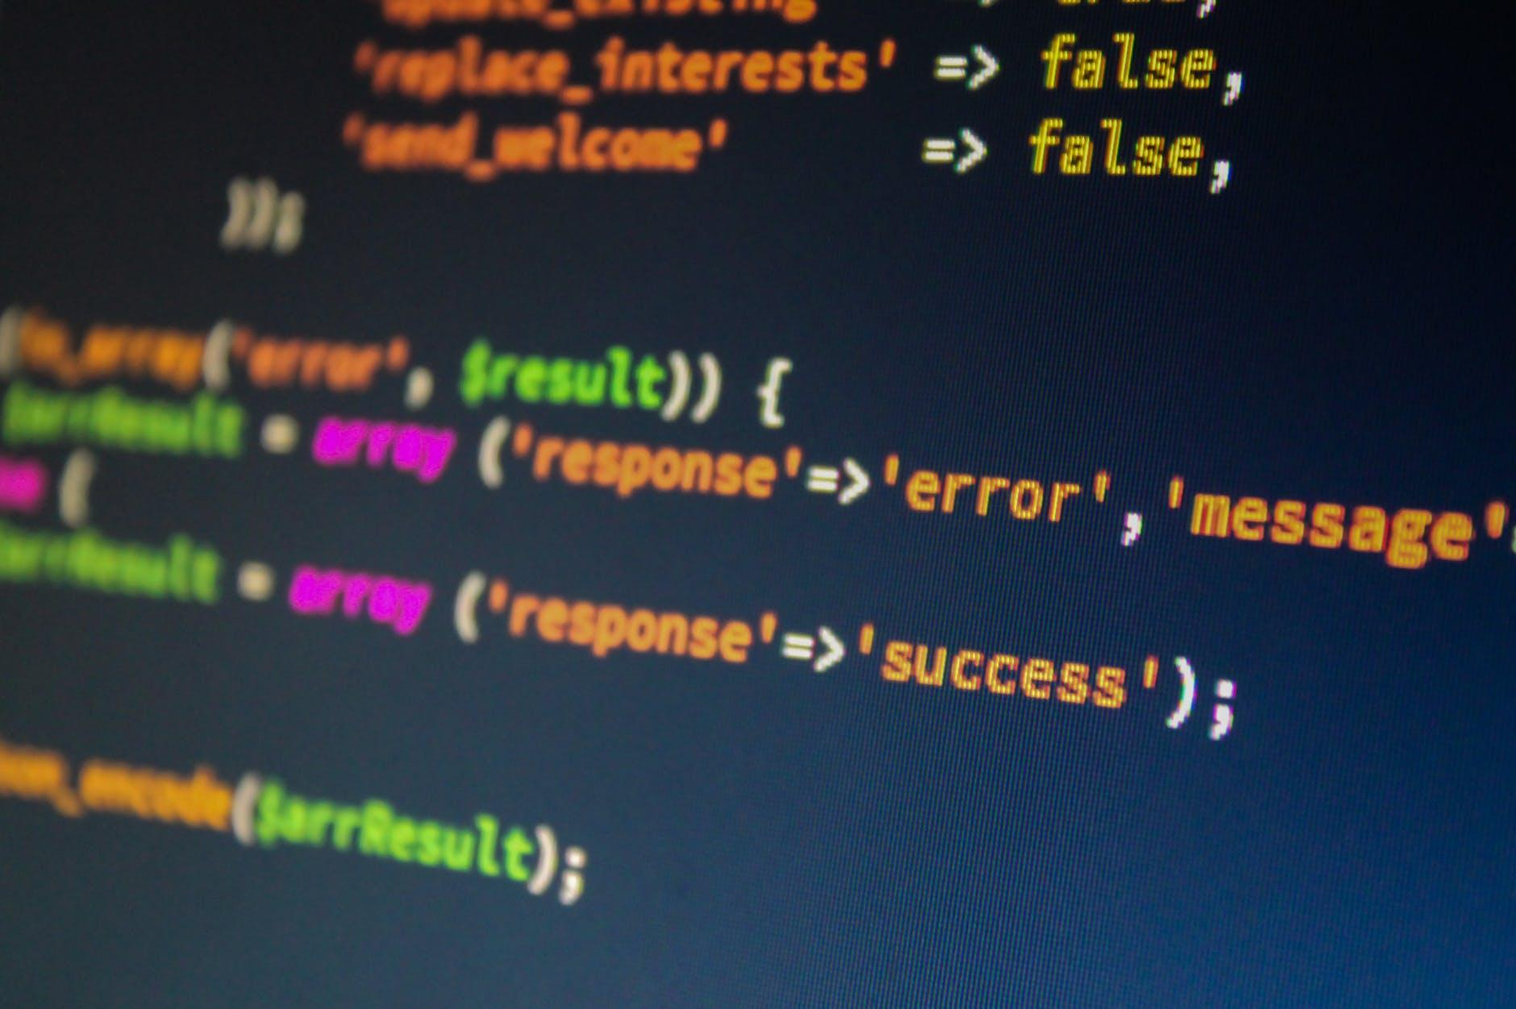
Ethical Challenges: Privacy and Security
Notes:
Finally, privacy and security were heavily cited concerns about using these analytics. Privacy and security violations can diminish trust in an institution, and over time, that can erode the quality of education students are receiving.
Additionally, privacy and security violations carry penalties now in a way that haven’t always before.
The EU’s General Data Protection Regulation, GDPR, allows countries to levy fines against corporations and institutions that don’t properly protect data for up to 4% of their global revenue. As more colleges are setting up satellite campuses, colleges increasingly need to think about how laws in other countries balance with collecting data and using analytics.
Locally, California passed a law last summer following in the steps of the GDPR. The California Consumer Privacy Act allows the state and individuals to sue businesses and institutions for both intentional and unintentional privacy and security breaches.

Slide 12
Notes:
In response to what we heard from colleges about the ethical challenges that come with implementing and using predictive analytics, we put together a guide of guiding practices, drawing from best practices and conversations with schools who have successfully done the work.
We’ll get into a little bit of that research now.

Slide 14
HAVE A VISION AND PLAN
Convene key staff to make important decisions
Things to consider:
Purpose
Potential consequences
Outcomes to measure
Notes:
Having the right people on your team is key in a way that can’t be understated. It’s a recurring theme in our guiding practices for a reason. The right team--from data experts in IR, enrollment management, student affairs, faculty, etc--goes a long way.
Then you want to consider three things from the outset:
Purpose -- why are you wanting to implement predictive analytics? What is it you want to achieve?
Consequences -- what are the potential consequences, both intended and unintended
Outcomes -- what does success look like? What does failure look like? What do you want results to look like immediately? In the first year, second year etc.

Slide 16
BUILD A SUPPORTIVE INFRASTRUCTURE
Assess institutional capacity
Communicate the benefits of using predictive analytics
Create a climate where it can be embraced
Develop a robust change management process
Notes:
What is your institution’s capacity for doing this work?
Specifically: what’s your budget? Are the funds there for to build out or purchase a system that can be fully integrated? Do you need to start small and use the efficiency savings from increased retention or something else to invest in a larger system?
Assess your data infrastructure. Do you have a strong data governance system in place? Are the right people for this on your team already?
Finally, staffing. There’s that team theme again. Who on your team knows the data inside and out. Who knows the model inside and out?
Then, there’s climate. Predictive analytics can change the way your support staff and maybe even faculty do their jobs. It’s important that they are bought in. Everyone involved should at least know why it’s worth it. Change is already hard--it’s even harder when the people responsible for implementing the change don’t believe in it.
Finally, a change management process. What we mean here is… make sure the changes that come from your predictive analytics work meet your institution’s goals and support, not supplant, (a little HEA pun for y’all) resources already at your institution.

Slide 17
CHOOSING A VENDOR
Considerations for building your own system
Cost
People
Institutional capacity to act on data
If you decide to partner with a vendor…
Notes:
Choosing the right vendor is key to implementing predictive analytics ethically and building a supportive infrastructure
We heard over and over in our conversations with colleges that the information asymmetry between vendors and colleges was causing a lot of strife when trying to implement these systems
So we created a guide for colleges on choosing vendors.
First, we addressed whether a college wanted to partner with a vendor or build their own analytics solution
The answer to that depends on the college’s capacity to use data and their ability to make an internal system sustainable
Colleges need to consider the whole cost of creating their own system not just consider it free
To make it sustainable you have to have the right people and make sure enough people know how to work with the custom system so it isn’t reliant on one or two people
The kind of analysis needed to meet the college’s need and whether that is possible in house
And the colleges capacity to act on data
For a lot of schools, this is where thinking about a vendor is important. For some it isn’t.
If you have the capacity and capability to build your own system, consider the cost, the people it will take and your team, and then your institution’s capacity to act on data.

Slide 19
WORK TO ENSURE PROPER USE OF DATA
Make sure your data is…
Complete and high quality
Interpreted accurately
Private and secure
Notes:
There are three keys here.
First, make sure data is complete and high quality--that you’re identifying the right students for the right things. Again, a solid data governance structure is can help with this.
Make sure data is interpreted accurately. We’ll get into this in our next principle, but humans are notoriously bad at internalizing and interpreting probabilities. Make sure your staff is trained on how to do this accurately.
Finally, make sure data is private and secure. For a lot of schools, the key to this is choosing the right vendor, as we discussed. But the same rules apply in-house: hold your teams to the same standard you have to hold third-party vendors and companies to.

Slide 21
MODELS THAT AVOID BIAS
Choose a vendor wisely
Test and be transparent about models
Notes:
Speaking of slides that could be a whole seminar, this. For now, I’ll just say that this is about thinking about all the issues we’ve touched on when buying or designing predictive analytics systems.
Choose your vendor wisely. There are a lot of considerations. And then there’s our guide.
But there’s also testing and being transparent about your models. Test them. Document them. Don’t be afraid to be open about findings so you can workshop them. Doing a disparate impact analysis early on will save you a lot of heartache in the long run.

Slide 23
INTERVENE WITH CARE
Carefully communicate to students when deploying interventions
Train staff on implicit bias and the limits of data
Evaluate and test interventions
Notes:
Finally, and maybe most importantly, intervene with care. This is the most human element of all of this.
For starters, communication is key. It’s important to recognize that one message can have different effects on different communities.
As a part of our guiding practices research, we dug into a paper about an experiment among French universities where students who were struggling in their majors were given a warning about how that major “may not be right for you.” Their biggest finding was that the students who were most likely to drop out as a result of getting that intervention were students from low-income, first generation backgrounds. So message matters.
Train your staff on implicit biases. This is a non-negotiable in using predictive analytics. We all have biases, and when we see them reinforced in data, sometimes it makes us think that we don’t. So train the staff delivering interventions on how to avoid this.
Finally, test and evaluate. The message is the same: test your interventions for disparate impact. Document it. Be transparent about your findings.

Slide 24
THOUGHT EXCERCISE
You lead a committee that administers a confidential campus climate survey asking students questions about how connected they feel to faculty, staff, and other students, involvement on campus, exercise, free-time, and study habits, and more.
Your Student Life office, who you’ve involved in the process, indicates that research shows some combinations of responses may indicate deteriorating mental health.
Your school has recently had a number of mental health related incidents. Some members of your office suggest monitoring students based on their responses. Others recommend reporting students for pre-emptive counseling services.
In your opinion, what’s the appropriate course of action? Does it violate the promise of confidentiality? If so, do you feel it can it be justified? Discuss with your neighbors.

Slide 25
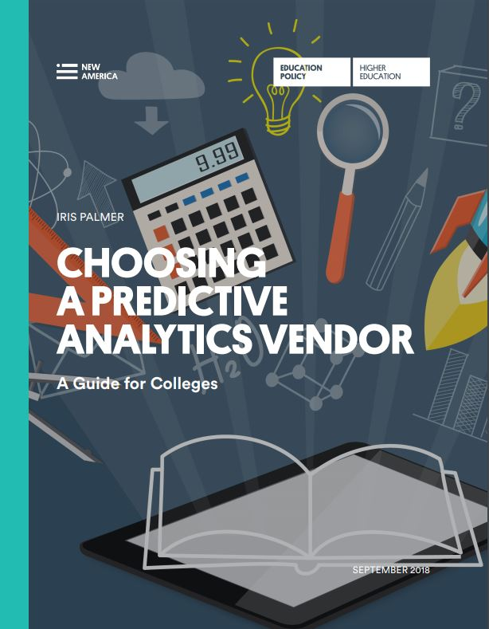
NEW AMERICA’S RESEARCH ON PREDICTIVE ANALYTICS
Find all of our reports at newamerica.org/education-policy/topics/innovation-education/predictive-analytics/
Notes:
Even though we gave you a lot of information, we only covered the surface level of the suite of research New America has done on predictive analytics in higher education. We’ve published three papers on our research that you can find at newamerica.org. I’ve also tweeted out links to each of the papers. They are…

Slide 26
THANK YOU!
Ernest Ezeugo
Policy Director, National Campus Leadership Council
For more predictive analytics research, connect with New America:
Twitter: @NewAmericaEd
Email: palmer@newamerica.org
Stay in touch!
Twitter: @ErnestEzeugo
Email: ernest@campusleaders.org

